Slide 1
BLOOD BANK MANAGEMENT SYSTEM
SUBMITTED BY,
JAYAKRISHNA SUKUMARAN – 181CO223
SANGEETH S V – 181CO246

Slide 2
INTRODUCTION
This project is aimed to developing an online Blood Donation Information. The Blood Donation Agent is to create an e-Information about the donor and organization that are related to donating the blood. Through this application any person who is interested in donating the blood can register himself in the same way if any organization wants to register itself with this site that can also register. Admin is the main authority who can do addition, deletion, and modification if required. The internal database has been selected as My-SQL server.

Slide 3
TABLES
Entities Planned To Be Used:
• Donors
• Patients
• Donation Camps
• Sponsors
• Organizations

Slide 4
DONORS
Attributes:
DSSN (PK)
EMAIL
PASSWORD
DNAME
DOB
BLOOD_TYPE
ADDRESS
HEALTH
CAMP_ID (FK)

Slide 5
PATIENTS
Attributes:
PSSN (PK)
EMAIL
PASSWORD
PNAME
DOB
BLOOD_TYPE
ADDRESS
URGENCY
REGISTERED_DATE
ORGANISATION_NO (FK)

Slide 6
DONATION CAMPS
Attributes:
LOCATION
CAMP_ID (PK)
ORGANISATION_NO(FK)

Slide 7
SPONSORS
Attributes:
SPONSOR_ID (PK)
SPONSOR_NAME
EMAIL
AMOUNT
ORGANISATION_NO (FK)

Slide 8
ORGANIZATIONS
Attributes:
ORGANIZATION_NO (PK)
ORGANIZATION_NAME
NUM_OF_PATIENTS

Slide 9
RELATIONSHIPS
DONATED_TO – Relates DONORS and DONATION_CAMP (1:N)
ORGANIZED_BY – Relates DONATION_CAMP and ORGANIZATIONS (1:1)
RECEIVED_FROM – Relates PATIENTS and ORGANIZATIONS (1:1)
SPONSORED_BY – Relates SPONSORS and ORGANIZATIONS (N:1)

Slide 10
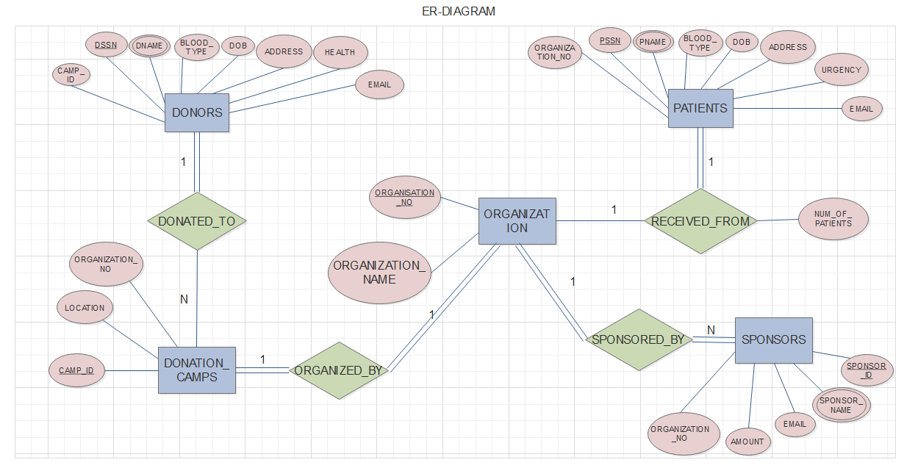

Slide 11
THE END

